Slide 1
Tarkvara projekt
GAME VISUAL NOVEL ADVENTURE
ILJA KUZNETSOV, MIHKEL ERIK RIID
Notes:
1

Slide 2
The task
We are making an adventure in visual novel genre.
Notes:
2

Slide 3
Work division
Ilja – images for scenes, music, storyline and dialogues writing, battle system making, scene assigning and preparing for assembling.
Mihkel – save system, music player, settings, GUI, scene templates, scene assembly, part of images for scenes.
Notes:
3

Slide 4
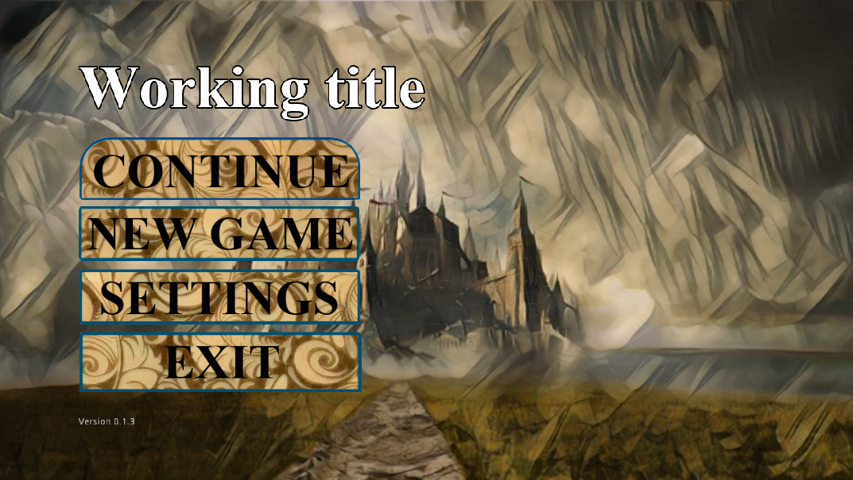
What is already done
Title screen
Notes:
4

Slide 5
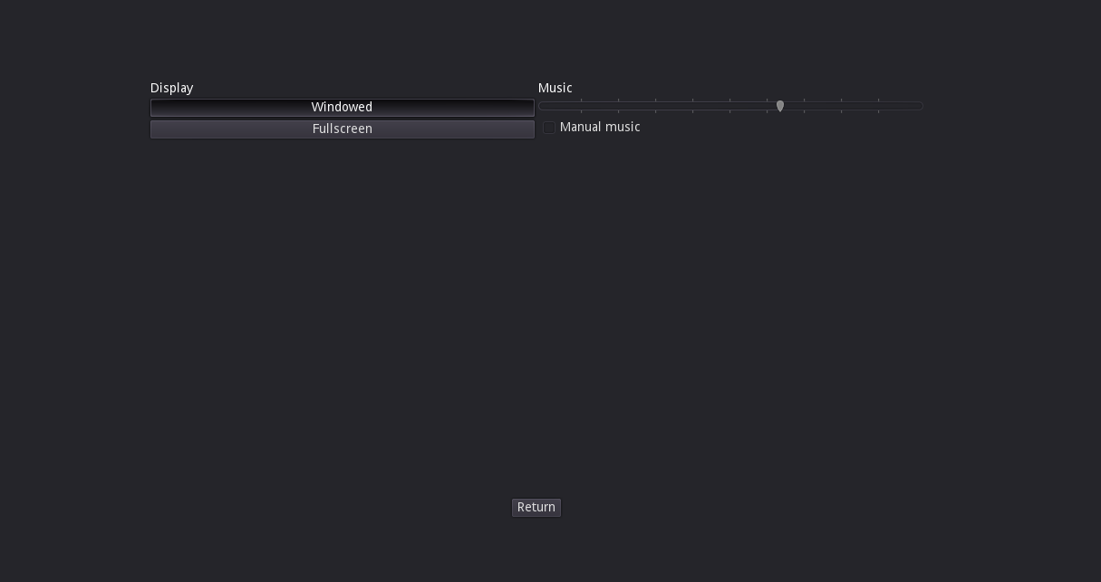
What is already done
Basic settings
Notes:
5

Slide 6
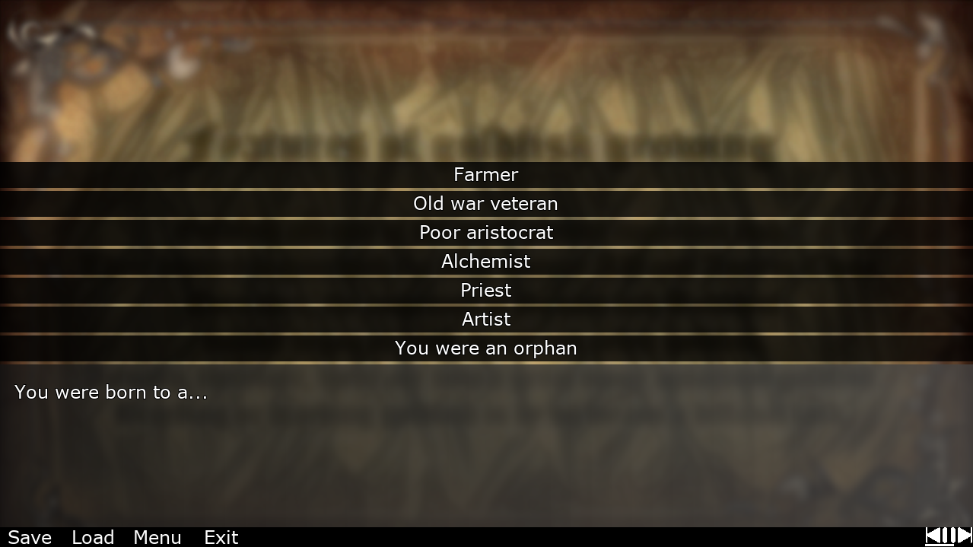
What is already done
GUI, scene template, music player
Notes:
6

Slide 7
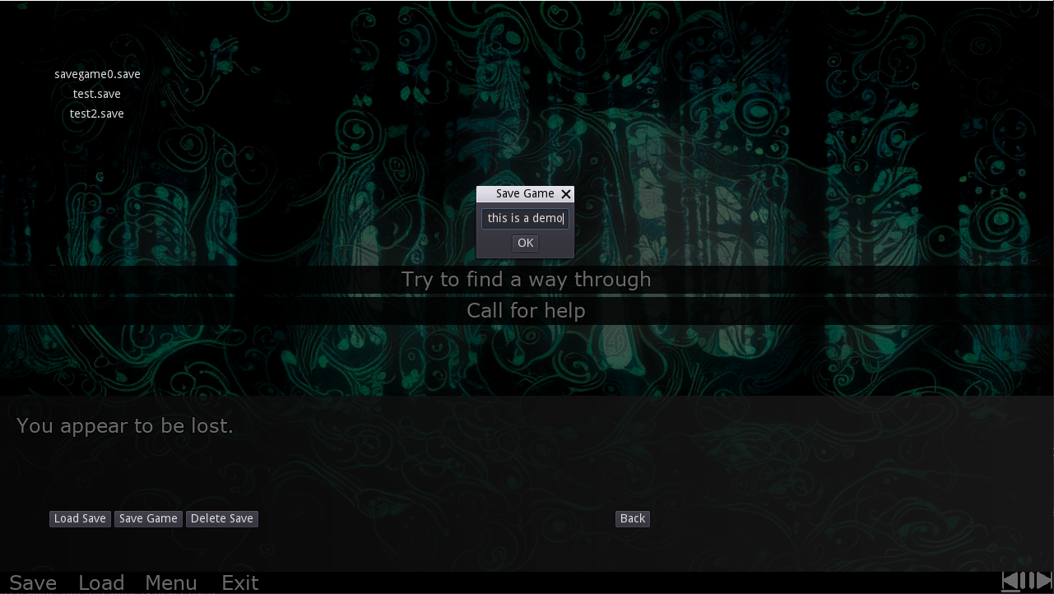
What is already done
Working save system
Notes:
7

Slide 8
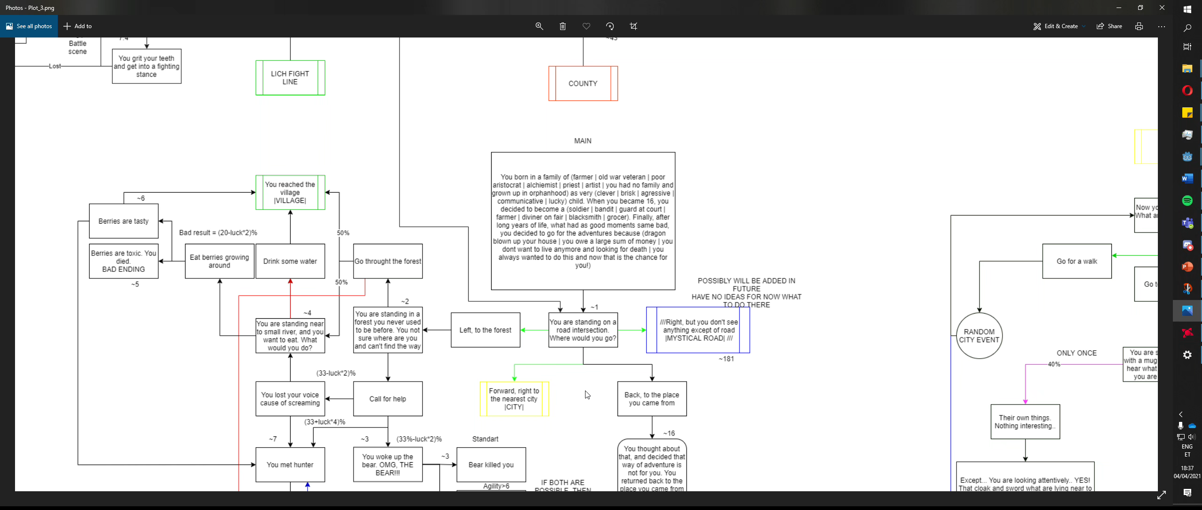
What is already done
Storyline and dialogues completed
Notes:
8

Slide 9
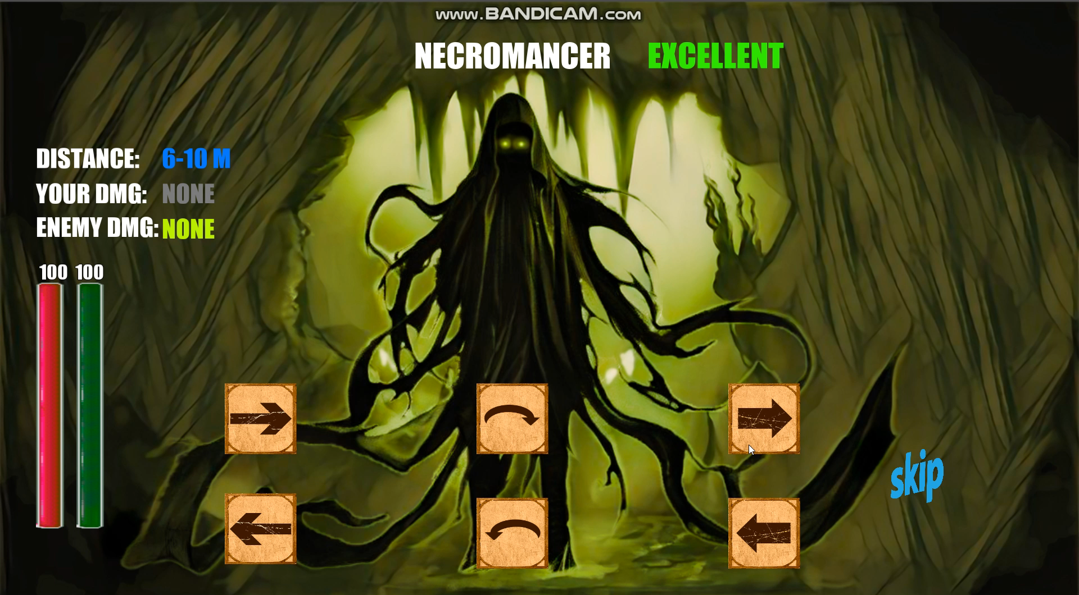
What is already done
Basic battle system prototype with fully functional enemy AI
Notes:
9

Slide 10
Necessary things to do
- Finish assembling all regular scenes
- Implement the battle system
- Test game for bugs and mistakes and get rid of them
Notes:
10

Slide 11
Optional things to do
- Add achievements system
- Add random events during the game
- Add graphical effects into battle system
- Add inventory system and items
- Make advanced musical player
- Karma system
Notes:
11

Slide 12
What has changed
- Inventory and items moved to optional aims - Karma system moved into optional aims
Notes:
12

Slide 13
Expected Result
- Learn Godot
- Make an amazing game
- Get an experience of command work and game-making
Notes:
13

